Slide 1






Microcontroller-Based Environmental Pollution Monitoring System through IoT Implementation
TEAM : Sustainability seekers
Members
Nathaniel
nelson
EVANS ACHEAMPONG

Slide 2
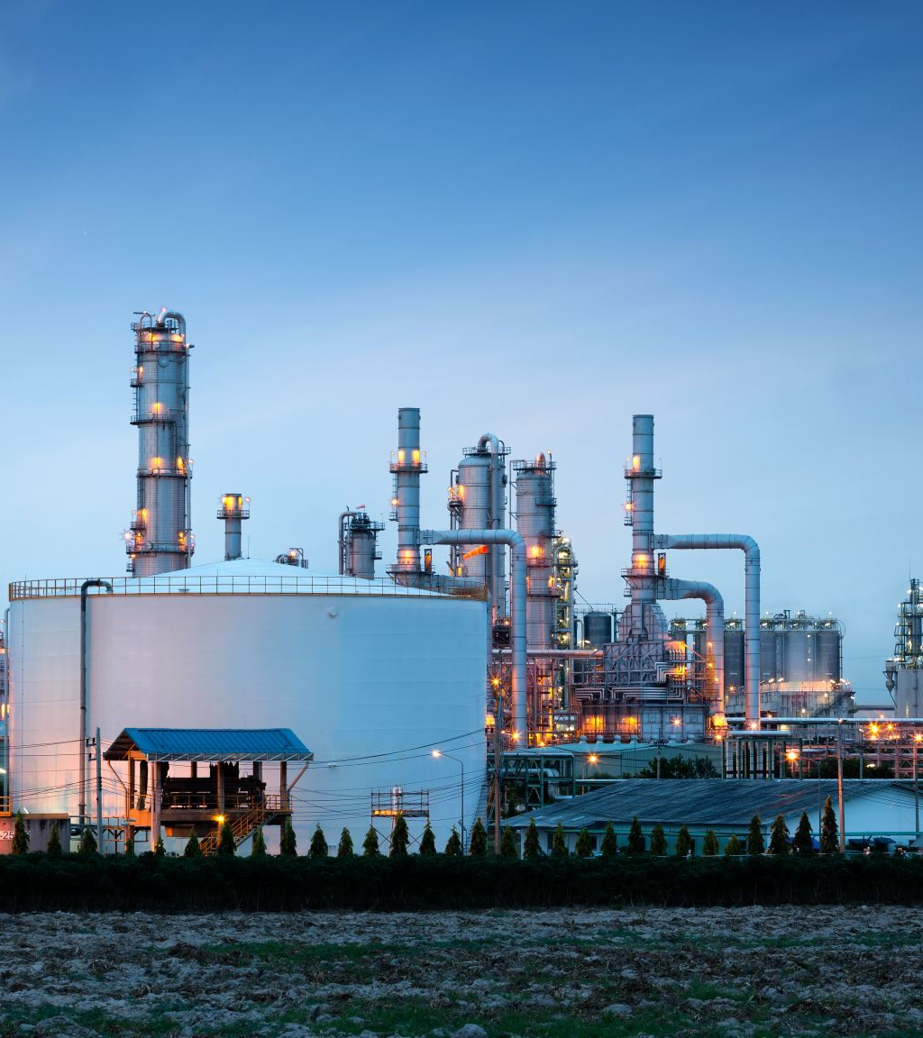
Introduction
Welcome to our presentation on the Microcontroller-Based Environmental Pollution Monitoring System through IoT Implementation.
Air pollution is a significant concern worldwide, affecting human health and the environment. We aim to address this issue with our innovative project.
Our team comprises 3 dedicated individuals with a passion for environmental protection.

Slide 3
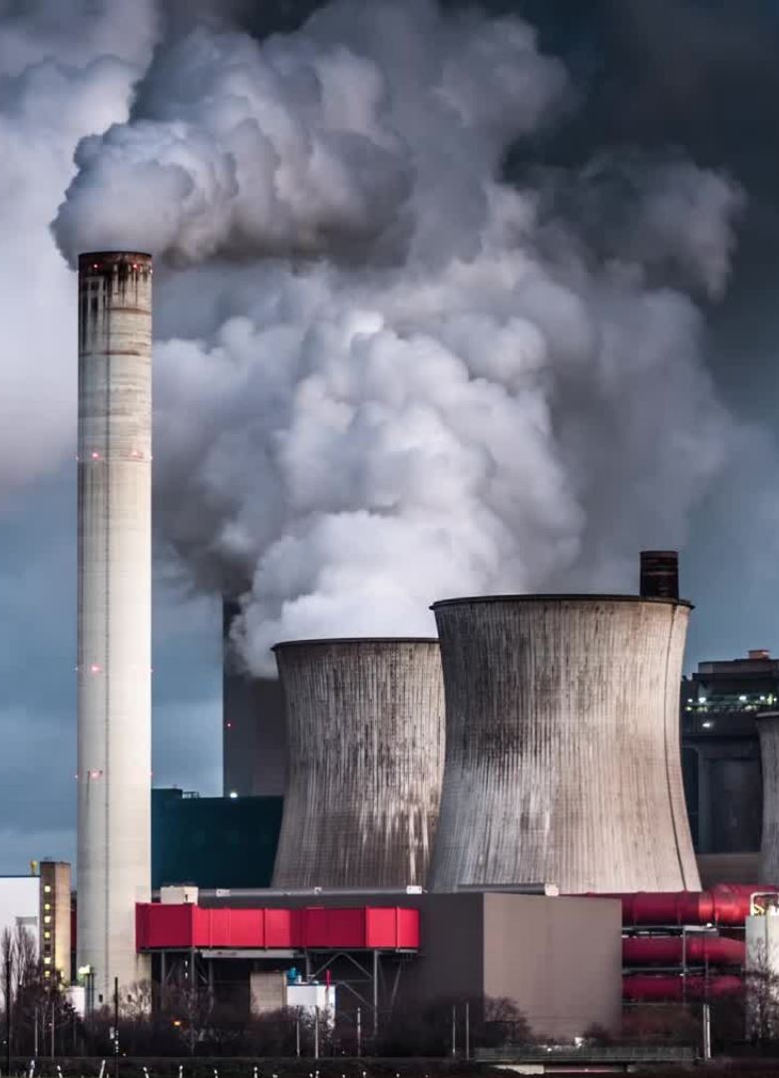
Problem Statement
Problem: Rapid escalation of air pollution has become a significant concern, impacting human health and ecosystem globally, especially in urban areas.
Target Market: Our project targets government agencies, environmental monitoring organizations, industries, healthcare providers, and the general public residing in high-pollution areas.

Slide 4
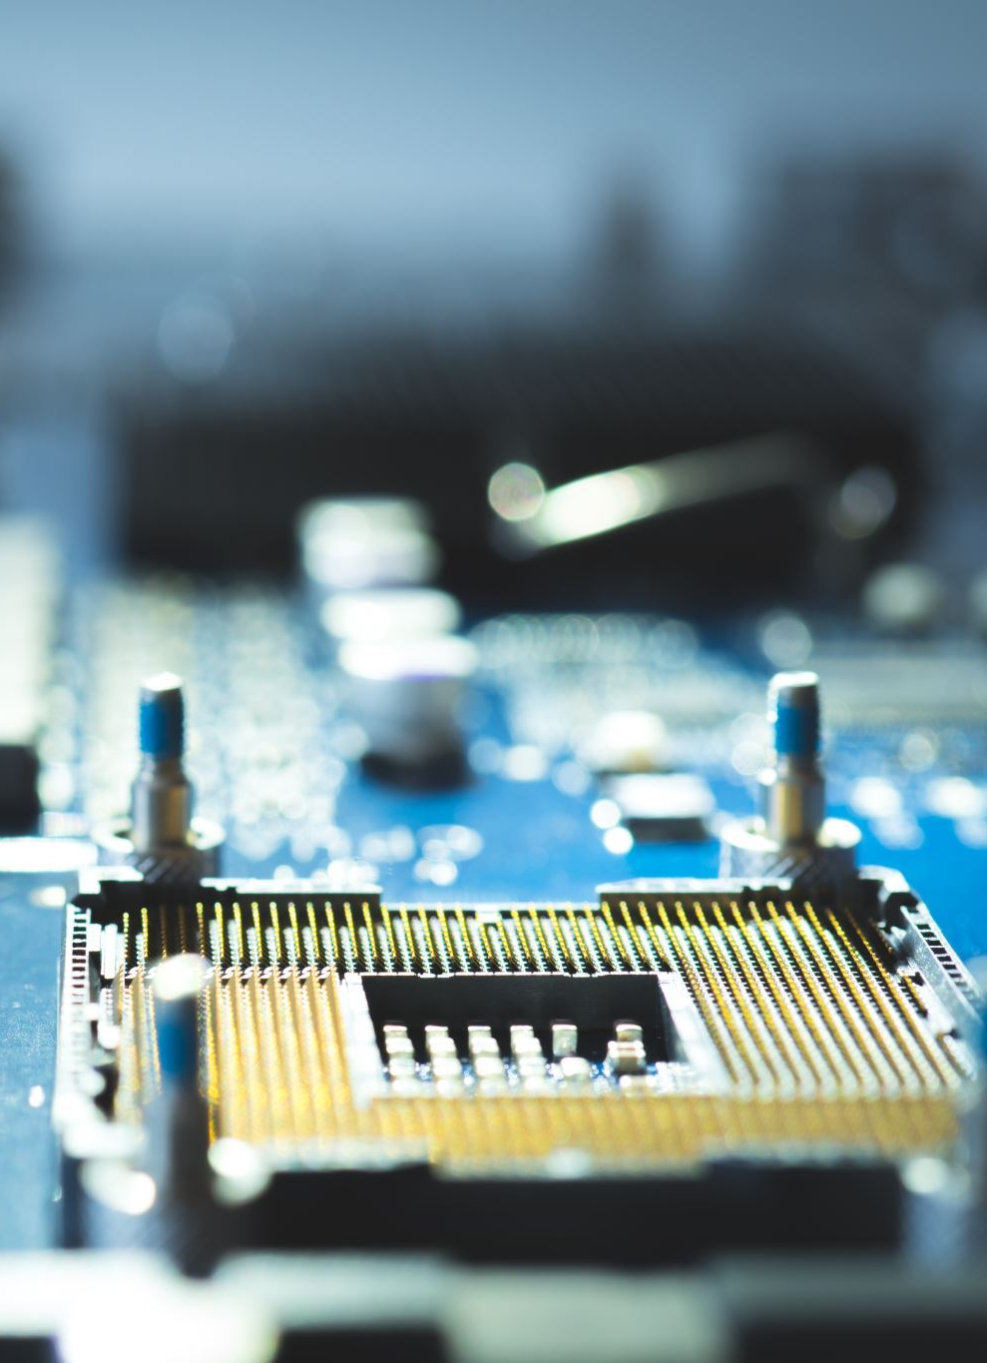
Solution Statement
Solution: We propose a Microcontroller-Based Environmental Pollution Monitoring System through IoT Implementation to provide real-time air pollution data and alerts.
Sensor Integration: The system incorporates MQ2, MQ4, MQ135, and MQ7 sensors to detect LPG, smoke, CO2, NH4, CO, and CH4 gas concentrations.
IoT Implementation: The collected data is transmitted to an online server via IoT technology, enabling remote access to pollution data from any location.

Slide 5
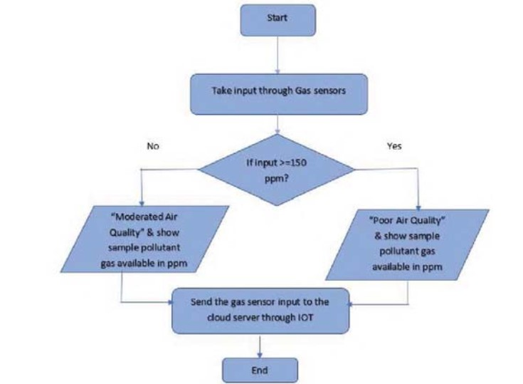
System Architecture

Slide 6
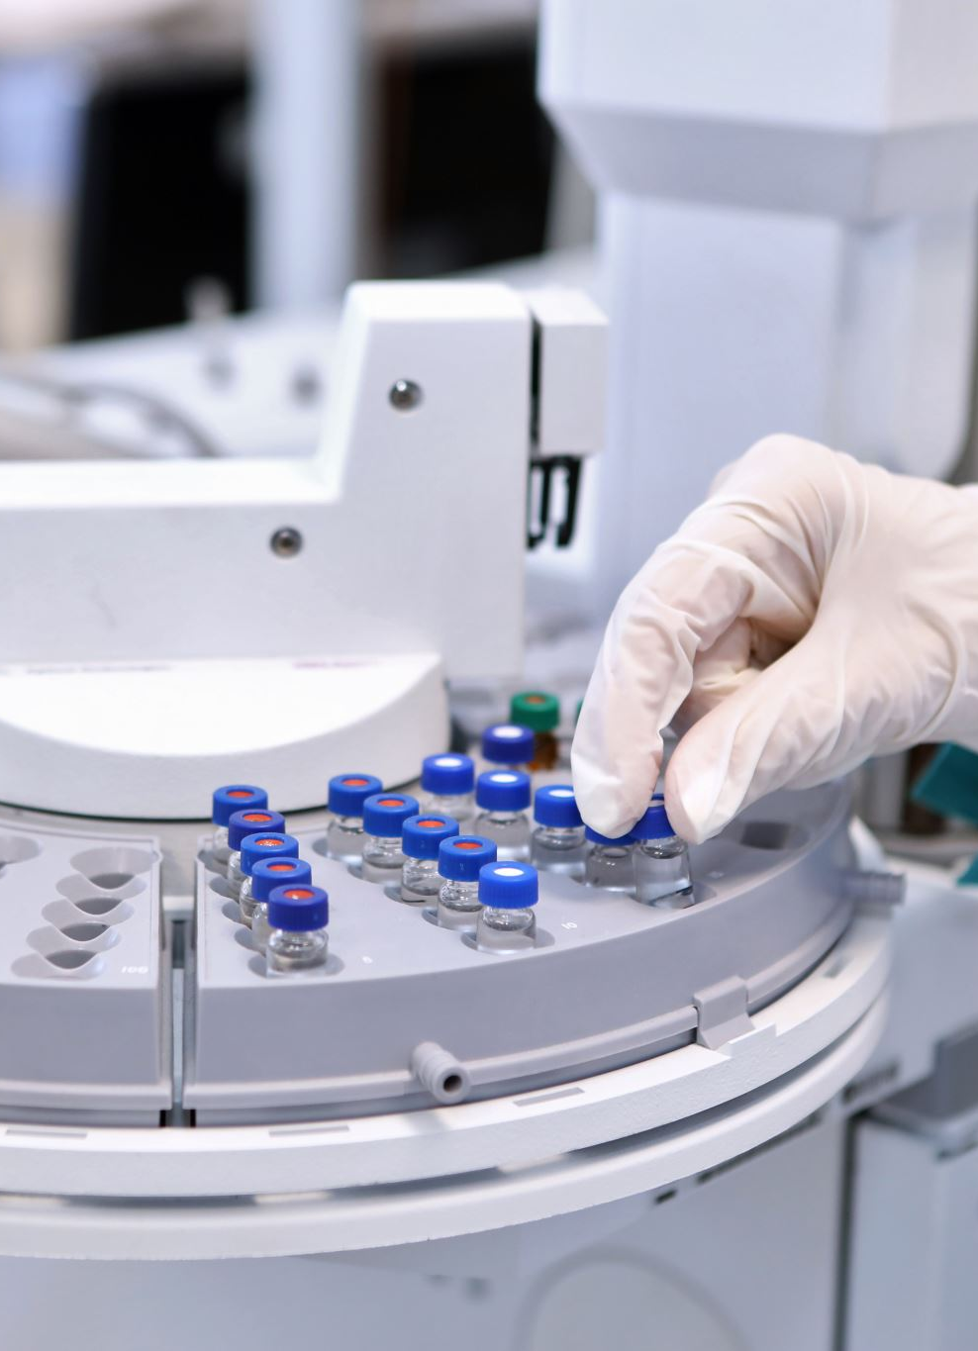
Calibration Process
Our system undergoes a calibration process to determine the baseline resistance (R0) of each sensor.
Calibration involves taking multiple readings of clean air to calculate the average R0 value for accurate pollutant measurements.

Slide 7
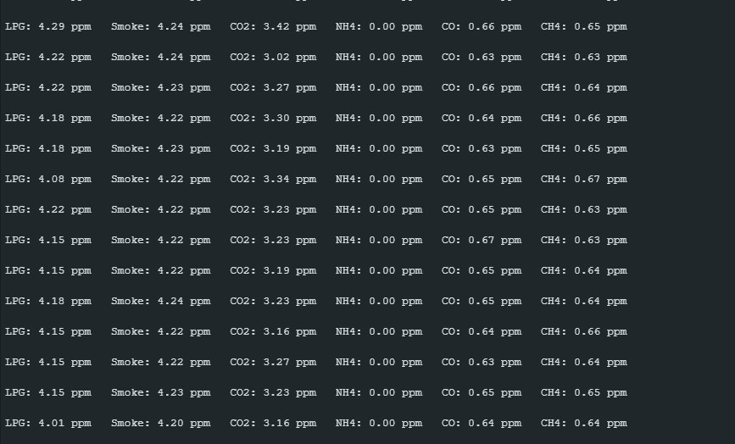
Data Visualization

Slide 8
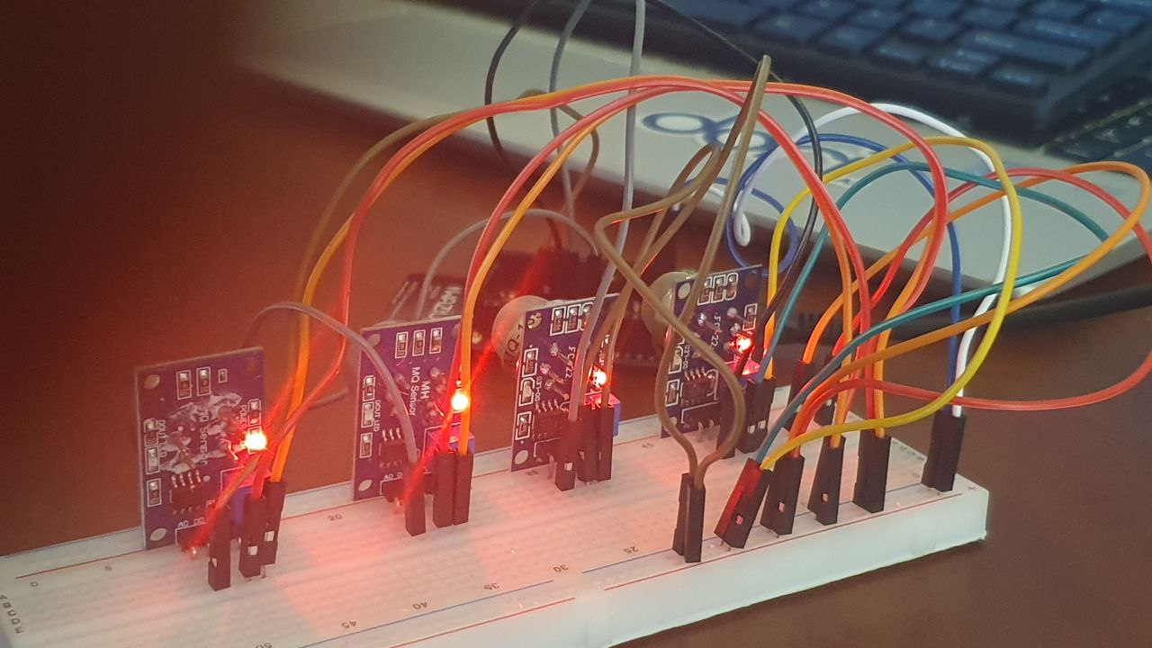
Demo

Slide 9
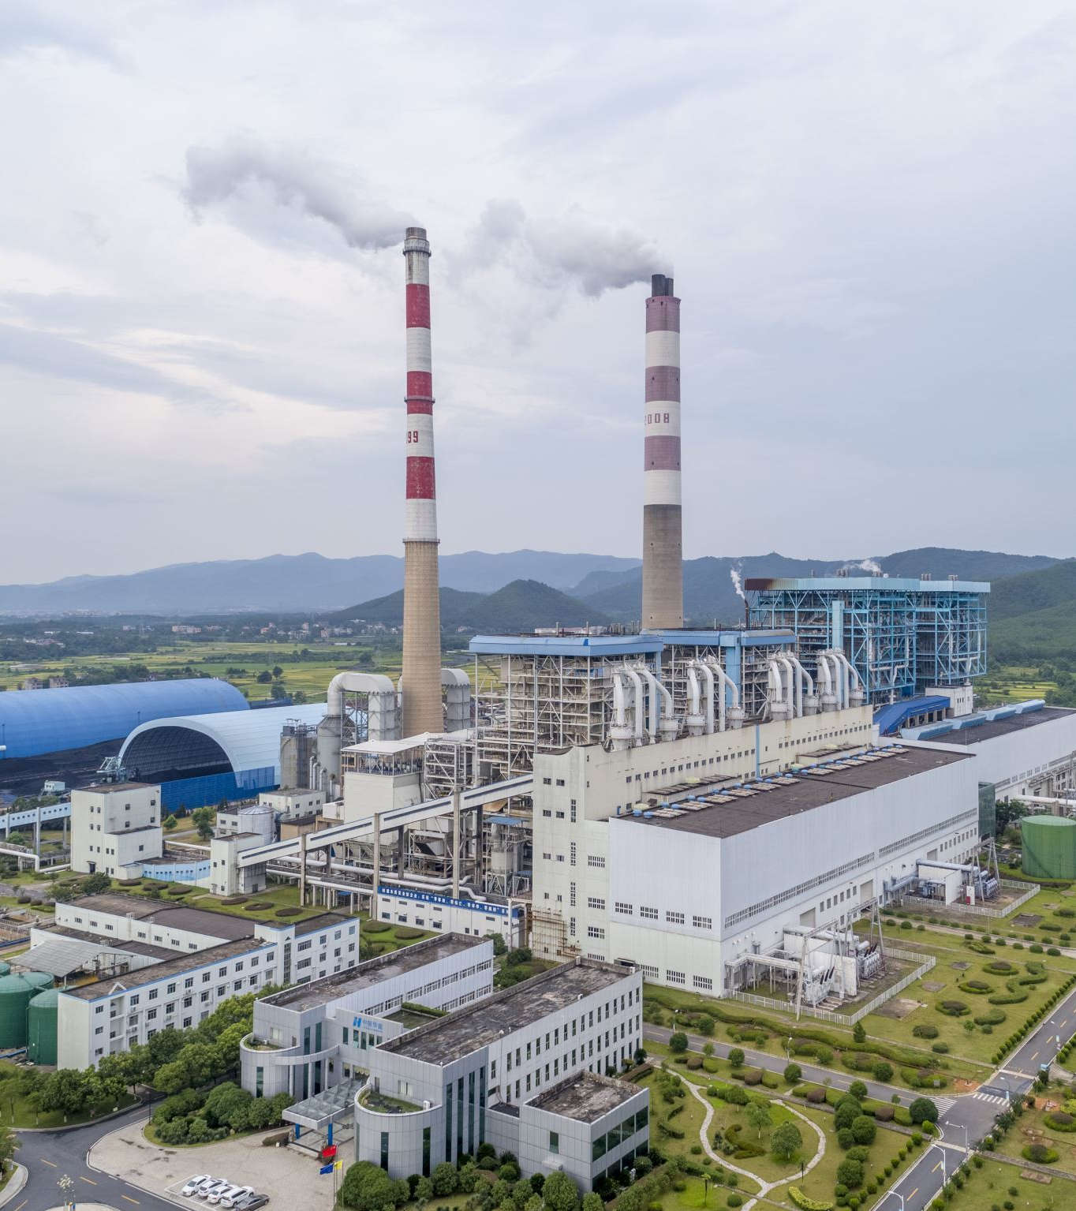
Benefits and Impact
Improved Air Quality: Our system helps users make informed decisions for pollution control, leading to improved air quality.
Health and Safety: Timely alerts protect public health, especially vulnerable populations, from harmful pollution exposure.
Environmental Preservation: By monitoring pollution levels, we contribute to preserving the environment and wildlife.

Slide 10

Challenges
Limited Memory Space: The code for the Microcontroller-Based Environmental Pollution Monitoring System already uses 83% of the Global Variables. This presents a challenge in accommodating additional features or optimizations without exceeding the available memory.
Connectivity Issues: Connecting the system to a Wazigate and the cloud has proved challenging, with the code exceeding 100% memory usage, preventing successful code upload to the board.

Slide 11

Future Enhancements
Scalability: Our system can be expanded to monitor additional environmental parameters and locations.
Machine Learning Integration: Incorporating machine learning algorithms can enhance data analysis and predictive capabilities.

Slide 12
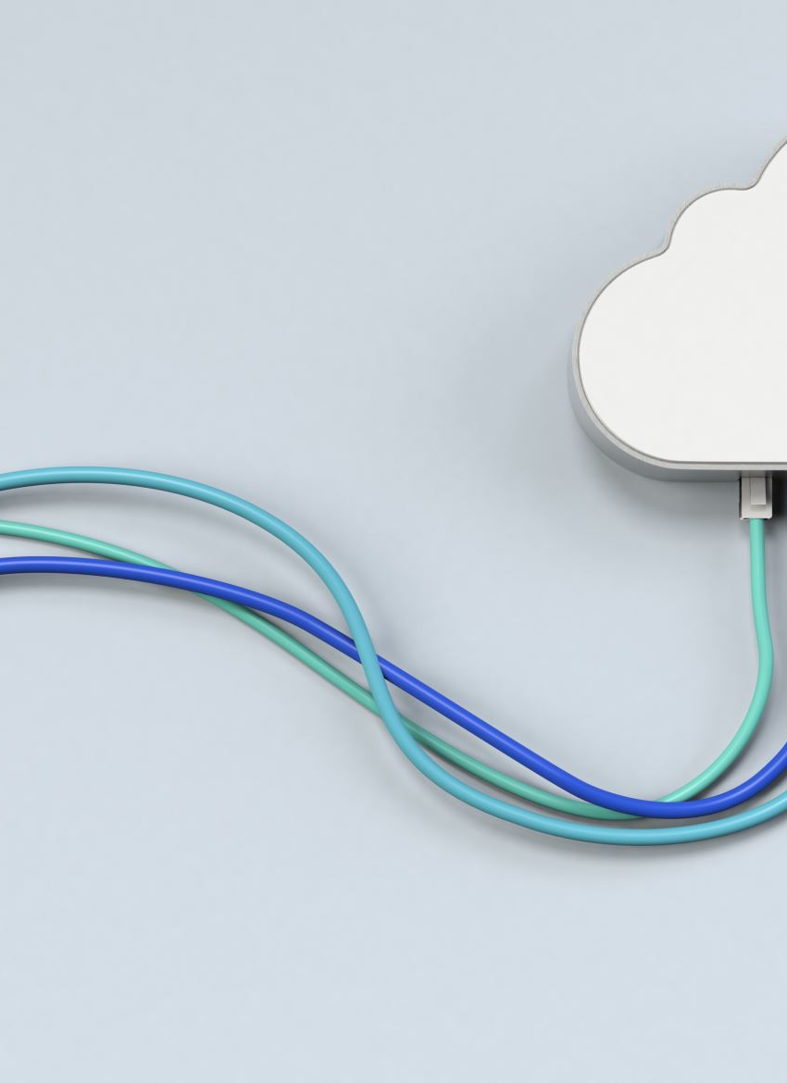
Conclusion
Our Microcontroller-Based Environmental Pollution Monitoring System through IoT Implementation is a powerful tool in the fight against air pollution.
We are committed to creating a cleaner and healthier environment for future generations.

Slide 13

Question Time

Slide 14

Thank You

